Slide 1

AI-Based Customer Support Automation System
Final Project Presentation & Demonstration
TEAM MEMBERS
Prajita Bhandari (12255441)
Akrishta Ale (12267761)
Ayush Bhandari (S12157470)

Slide 2



The Problem
The Core Problem
Manual handling can result in
Customer support teams often handle large numbers of repetitive enquiries such as:
Longer customer waiting times
Increased workload for support staff
Inconsistent ticket classification and prioritisation
Difficulty identifying urgent or complex cases
Limited visibility of support performance
Account and login issues
Product and service information
Order-related enquiries
Basic troubleshooting
General support questions
OUR CHALLENGE
How can AI automate routine customer support while ensuring complex or sensitive cases remain under human control?

Slide 3
Project Objectives
What We Wanted to Achieve
Develop an integrated customer-support platform that can:
1
Provide AI-assisted responses to common customer enquiries
7
Preserve conversation and ticket history
2
Automatically create and manage support tickets
8
Provide role-based access for Clients, Agents and Administrators
3
Categorise and prioritise customer issues
9
Support knowledge-base management
4
Analyse customer sentiment
10
Provide analytics and system activity logging
5
Assess AI confidence
11
Maintain secure authentication and access control
6
Escalate appropriate cases to human agents
MAIN GOAL Combine AI automation with human support rather than replacing human decision-making.

Slide 4




Solution Overview
AI Assistance
Ticket Management
Security
Administration
Automated responses
Category prediction
Priority assessment
Sentiment analysis
Confidence assessment
Escalation support
Ticket creation
Status tracking
Assignment
Agent responses
Resolution workflow
JWT authentication
BCrypt password hashing
Role-Based Access Control
User management
Knowledge Base
Analytics
System logs

Slide 5


Project Scope
What We Built
Outside the Original Project Scope
User registration and authentication
AI-assisted customer chat
Customer conversation history
Ticket creation and lifecycle management
Automatic ticket categorization
Priority assessment
Sentiment and confidence analysis
Human-agent escalation
Agent ticket management
Customer notifications
Knowledge-base management
Administrator user management
Analytics and reporting
System activity logging
Role-Based Access Control
Docker-based containerization
Cloud deployment
Native mobile application
Voice-based AI support
Video support
Multilingual support
Payment processing

Slide 6


Users and Roles
Client
Support Agent
Administrator
Register and log in
Chat with AI
Create support requests
View tickets
Track ticket status
Review conversation history
Receive support responses
View escalated tickets
Review customer conversations
Assign tickets
Respond to customers
Update ticket status
Resolve support cases
Manage users
Manage roles and account status
Maintain Knowledge Base
Review analytics
Review system activity logs

Slide 7



Team Contributions
Prajita Bhandari
Akrishta Ale
Ayush Bhandari
Backend Development & Database Lead
Frontend & UI/UX Lead
AI Integration & Intelligent Automation Lead
Spring Boot REST APIs
Database and JPA persistence
Authentication and JWT security
Role-Based Access Control
Ticket and conversation management
Agent functionality
Notifications
Knowledge Base backend
Admin user management
System logging
Exception handling
Analytics backend
Backend testing
React frontend
User interfaces
Client, Agent and Admin pages
Frontend API integration
Responsive UI
Frontend testing
AI service integration
AI response generation
Ticket classification
Priority analysis
Sentiment analysis
Confidence assessment
Escalation logic
AI/backend integration

Slide 8
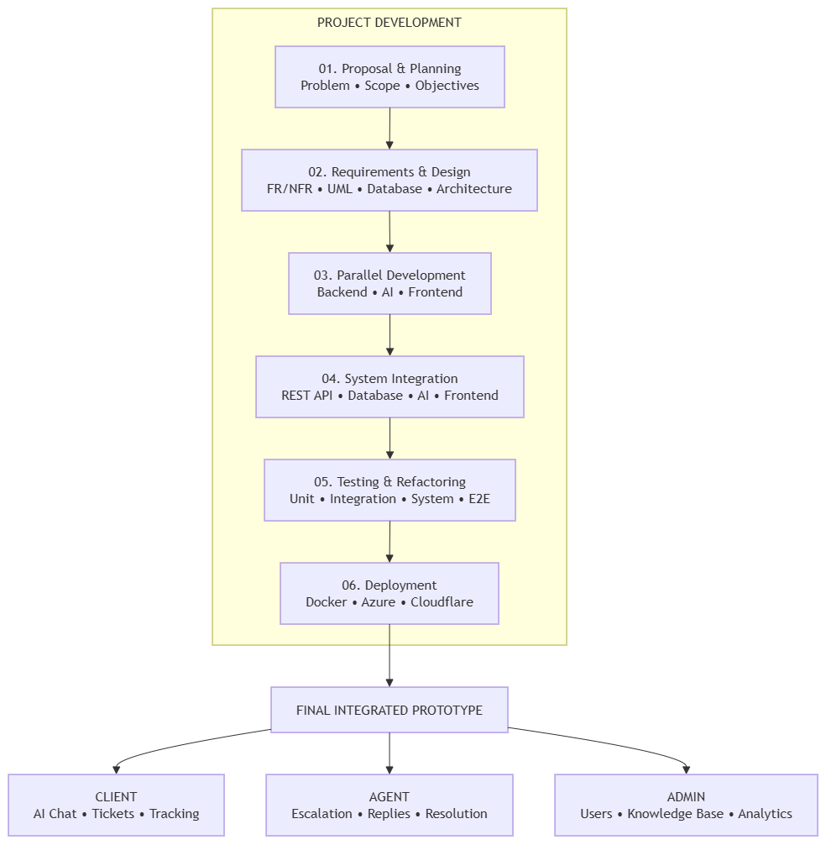
Project Development
Structured Planning: Defined 33 functional requirements, 20 non-functional requirements and UML designs.
1
Parallel Development: Developed Spring Boot backend, AI integration and React frontend across team responsibilities.
2
System Integration: Connected REST APIs, database, AI processing and role-based interfaces.
3
Testing & Refinement: Added unit, integration, system and end-to-end tests; resolved integration issues.
4
Project Tracking: Used GitHub issues, branches, commits, pull requests and team meetings.
5
Final Outcome: Delivered a Dockerised, cloud-deployed prototype supporting CLIENT, AGENT and ADMIN roles.
6

Slide 9
GitHub, Project Management & Technology Stack
Technology Stack
Project Management & Collaboration
Component | Technologies
Frontend | React 19, Vite, JavaScript, HTML/CSS
Backend | Java 21, Spring Boot 4.1.1, REST APIs, Spring Data JPA
Security | Spring Security, JWT, BCrypt, RBAC
Database | H2 (Local/Testing), MySQL 8.4 (Docker/Production)
AI Integration | OpenAI API, Structured AI Analysis, Local Fallback
Deployment | Docker, Docker Compose, Nginx, Microsoft Azure, Cloudflare
GitHub: Version control, issue tracking, branches and pull requests.
Team Development: Separate Backend, AI and Frontend development tracks.
Integration: Merged components into main, followed by testing and refactoring.
Progress Tracking: 154 commits recorded during the reviewed development period and 9 documented team meetings.
KEY PROJECT OUTCOMES
Integrated Frontend + Backend + AI + Database.
Implemented secure workflows for CLIENT, AGENT and ADMIN.
Developed automated tests and deployed an integrated prototype.
GitHub: https://github.com/prajitabhandari1234/AI-Based-Customer-Support-Automation-System

Slide 10
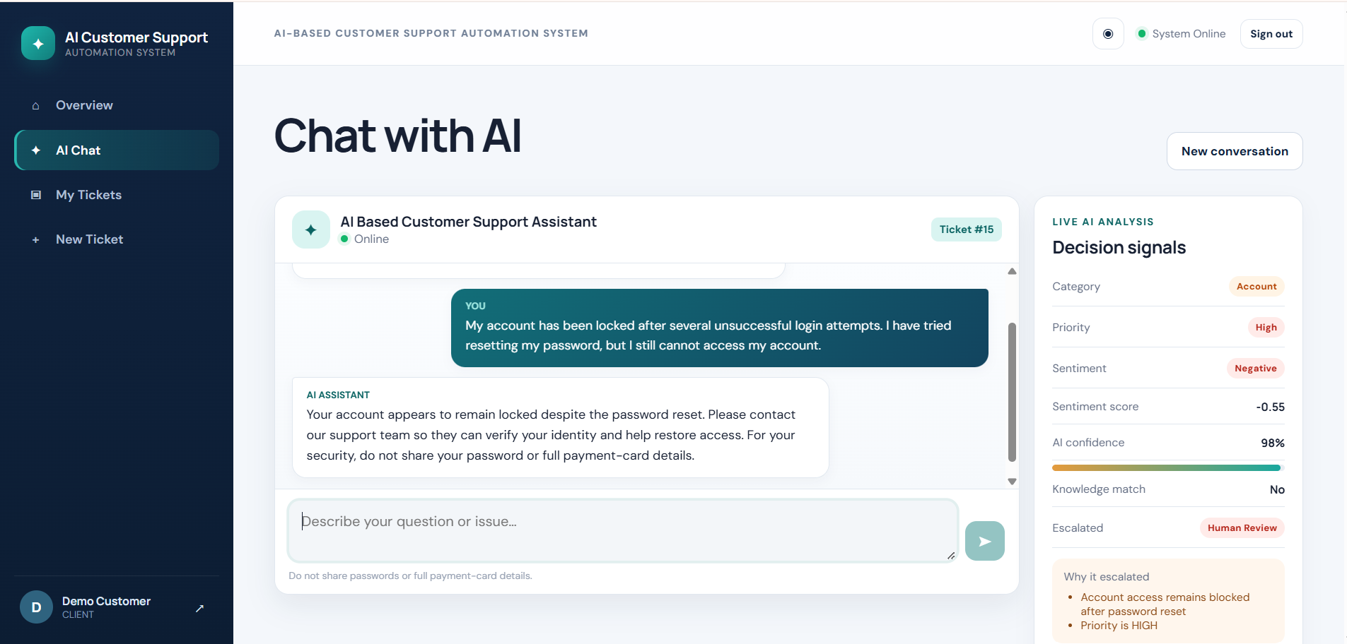
Live Demonstration: Client
Client Workflow
During the live demonstration we will show:
Client registration/login
AI-assisted chat
AI response
Ticket creation/escalation
Customer ticket list
Ticket details/status
Conversation history
Agent response visible to the customer

Slide 11
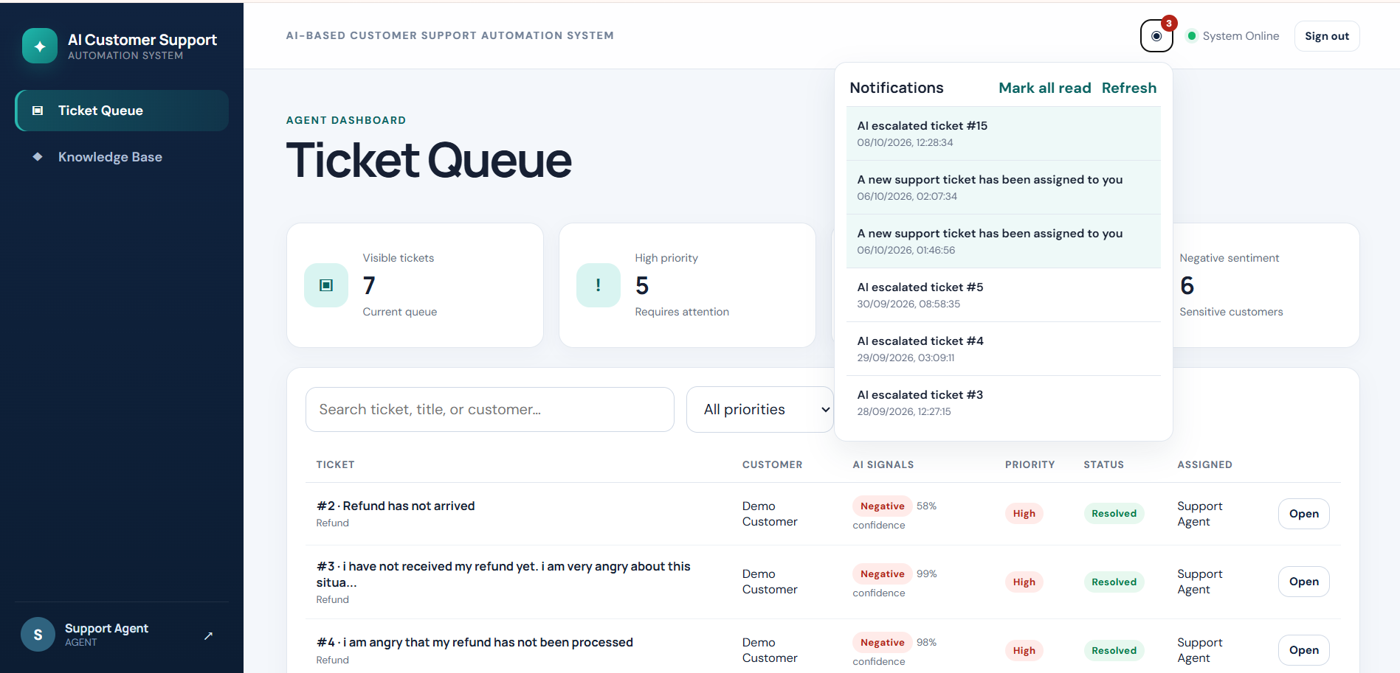
Live Demonstration: Support Agent
Agent Workflow
After the customer issue is escalated:
Agent logs in
Opens escalated ticket queue
Reviews ticket details
Reviews customer conversation
Assigns the ticket
Responds to the customer
Updates ticket status
Resolves the issue

Slide 12
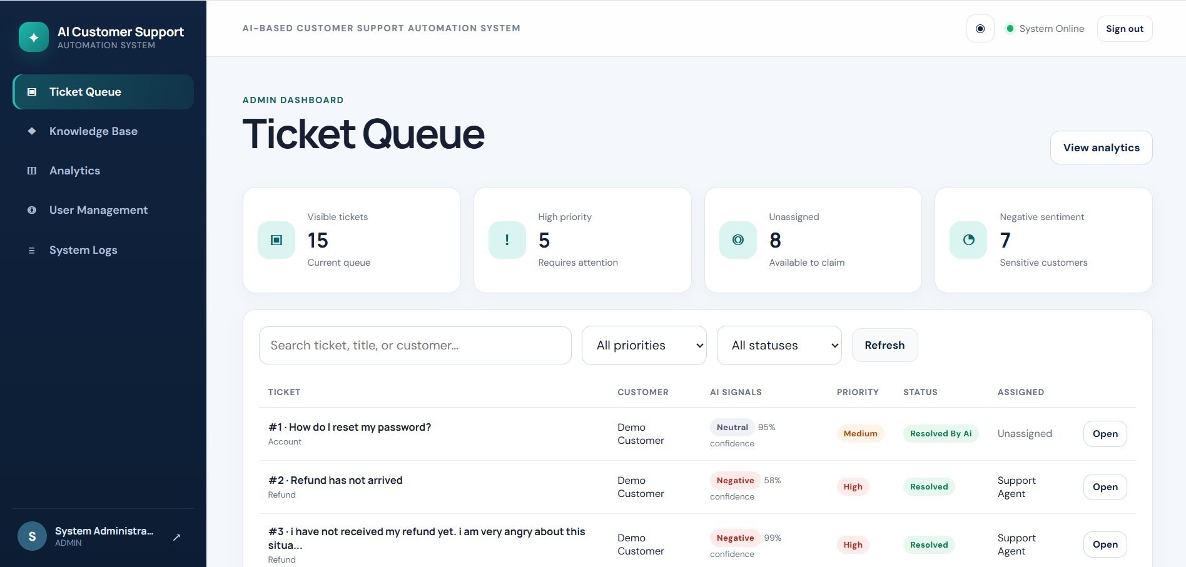
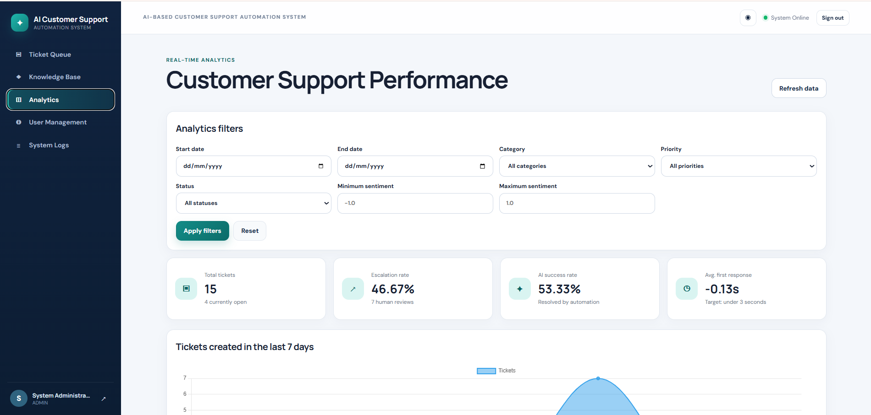
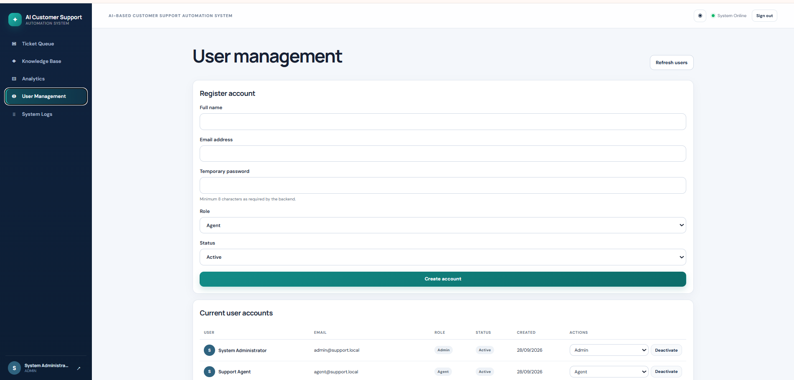
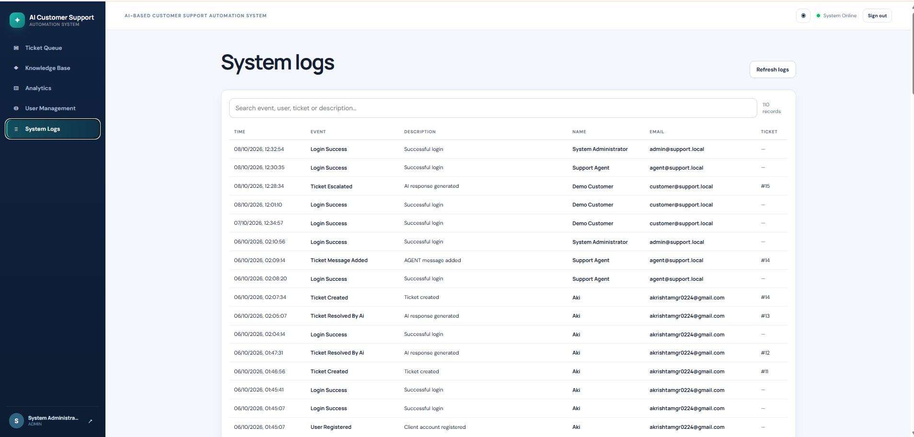
Live Demonstration: Administrator
Admin Workflow
The Admin interface provides:
User Management
  View users
  Create users
  Update roles
  Manage account status
Knowledge Base
  Create entries
  Update entries
  Delete entries
Analytics
  Ticket statistics
  Escalation information
  Support metrics
System Logs
  Review important application activities
Ticket Queue
Analytics
User Management
System Logs

Slide 13
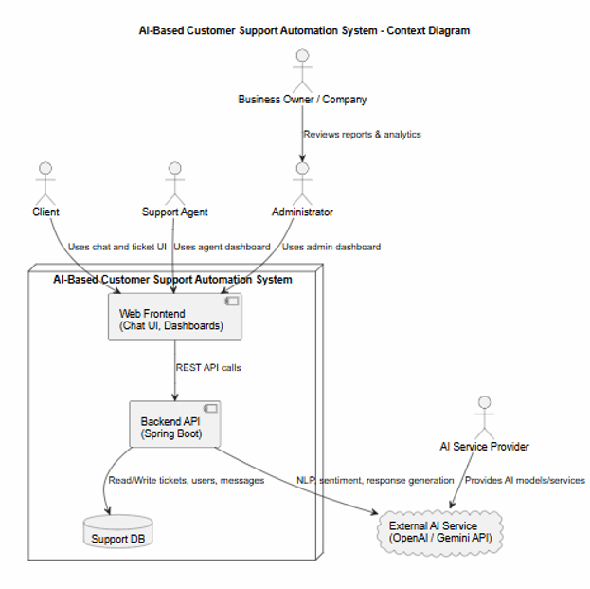



System Architecture
React Frontend: Role-based interfaces for CLIENT, AGENT and ADMIN.
Spring Boot Backend: REST APIs, controllers and business logic.
Security: JWT authentication, BCrypt password hashing and role-based access control (RBAC).
AI Integration: OpenAI-powered responses, ticket classification, sentiment analysis, confidence scoring and local fallback.
Database: Spring Data JPA with H2 for local development/testing and MySQL for Docker/production.
Supporting Services: Ticket management, human escalation, notifications, knowledge base, analytics and system logging.

Slide 14
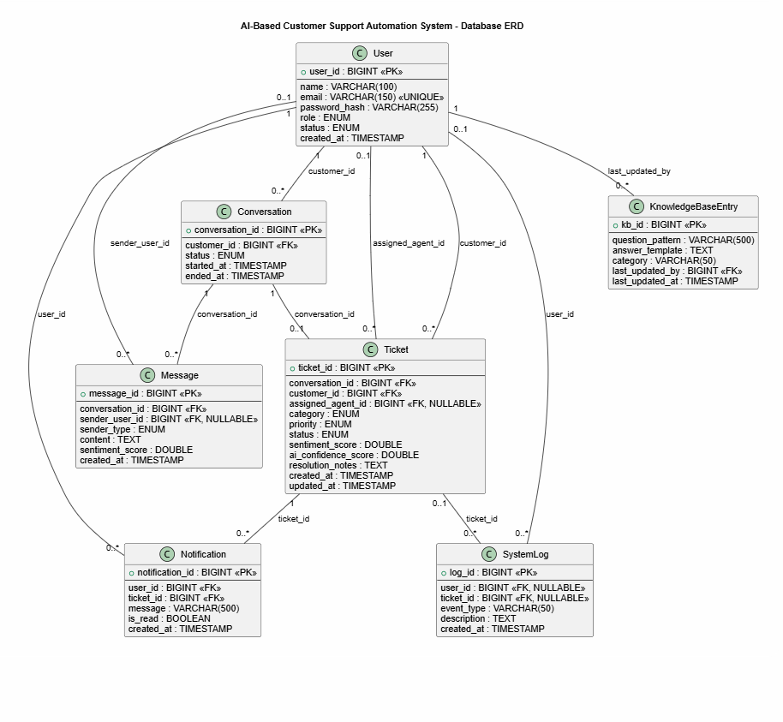




Database & Domain Model
JPA Entities: User, Conversation, Message, Ticket, KnowledgeBaseEntry, Notification and SystemLog.
User & Security: Stores account information, BCrypt password hashes, roles and account status.
Conversation History: Persists customer conversations and messages from clients, AI and support agents.
Ticket Lifecycle: Manages category, priority, sentiment, AI confidence, escalation, assigned agent and resolution status.
Supporting Features: Knowledge-base records, customer/agent notifications and system activity logs.
Database Integration: Spring Data JPA repositories with H2 for local development/testing and MySQL for Docker/production.

Slide 15
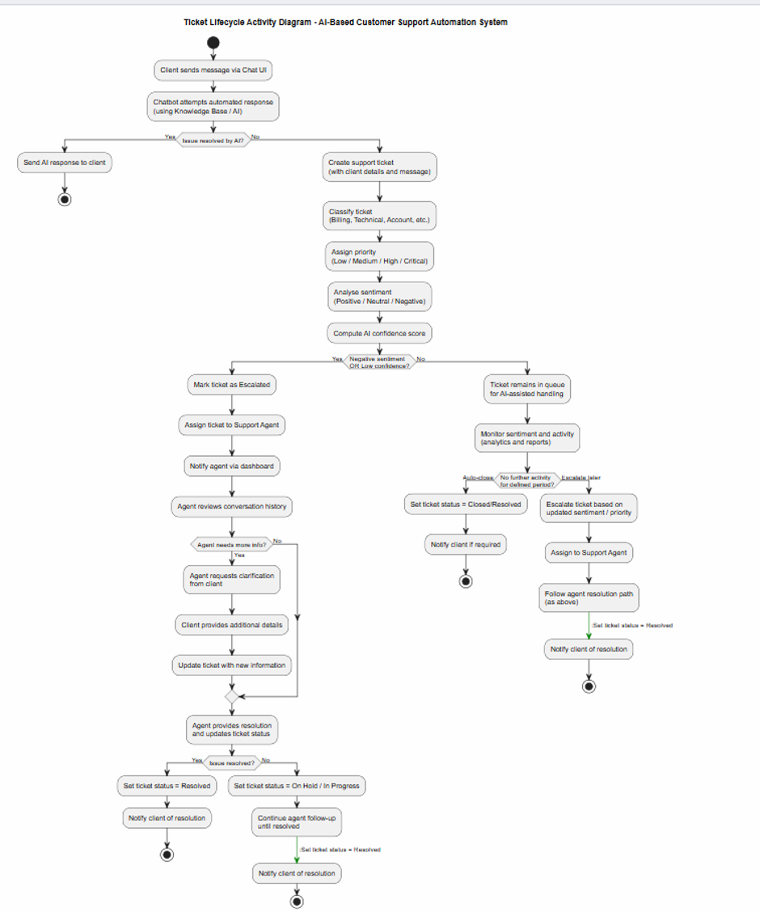
End-to-End Customer Support Workflow
Customer Interaction: The client submits a support enquiry through the React chat interface.
1
Knowledge Base: The backend checks for a matching knowledge-base answer before using external AI.
2
AI Processing: The system generates a response and analyses category, priority, sentiment and confidence.
3
Intelligent Escalation: Business rules determine when a ticket requires human-agent assistance.
4
Persistent Support Workflow: Conversations, messages, tickets and escalation details are stored for tracking and follow-up.
5

Slide 16
AI Integration, Security & Access Control
AI-Powered Decision Support
Security & Access Control
Response Generation: Provides AI-assisted customer support.
Classification & Priority: Identifies ticket category and urgency.
Sentiment & Confidence: Analyses customer sentiment and AI confidence.
Intelligent Escalation: Uses business rules to identify cases requiring human support.
Human-in-the-Loop: Agents manage escalated tickets and resolutions.
Authentication: JWT-based login and BCrypt password hashing.
Role-Based Access: CLIENT, AGENT and ADMIN permissions.
Data Protection: Resource ownership checks and protected REST APIs.
Input Security: Request validation and centralised exception handling.
Monitoring: Configurable CORS and system activity logging.
AI supports intelligent customer-service decisions, while role-based security protects users, data and administrative operations.

Slide 17


Testing & Verification
Backend Testing
Frontend Testing
The project includes automated tests covering:
Frontend testing covers:
API client behaviour
Components
Data normalisation
Integration behaviour
Formatting utilities
Authentication
JWT security
Role-Based Access Control
Customer ticket workflows
Customer chat workflows
AI decision integration
Agent/Admin workflows
API errors and CRUD behaviour
Validation
AI fallback/resilience
Additional Testing
Integration testing
System testing
End-to-end workflow testing
Performance-testing assets

Slide 18
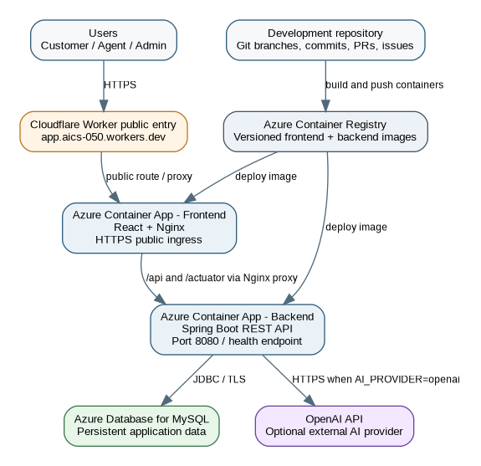




Deployment
Local Development: React frontend, Spring Boot REST API and H2 database.
Docker Containerisation: Docker Compose integrates React/Nginx, Spring Boot and MySQL services.
Azure Cloud Hosting: Frontend and backend deployed as separate Azure Container Apps.
Database & AI Integration: Azure Database for MySQL provides persistent storage; the backend supports optional OpenAI API integration.
Public Access & Routing: Cloudflare provides the public application entry point, with Nginx proxying API requests to the backend.
Deployment Link: https://app.aics-050.workers.dev/login
DEPLOYMENT BENEFIT Containerisation provides consistent environments, while Azure and Cloudflare enable cloud hosting and public application access.

Slide 19

Challenges & Lessons Learned
Challenges
How We Responded
Lessons Learned
During development, we encountered:
Standardised API contracts
Added deterministic AI fallback behaviour
Strengthened JWT/RBAC and ownership checks
Improved exception handling
Refactored integrated code
Expanded automated testing
Used Docker to reduce environment differences
Integration should begin early
API contracts must remain consistent
AI output requires validation and fallback behaviour
Security must be designed across the whole workflow
Automated testing becomes increasingly important as a system grows
Git collaboration requires clear team responsibilities
Frontend/backend response mismatches
AI-provider availability
AI response consistency
Role and ownership security issues
CORS and production routing issues
Integration conflicts between team branches
Increasing testing requirements as the system expanded

Slide 20
Conclusion & Project Achievements
PROJECT OUTCOME
KEY ACHIEVEMENTS
The project successfully developed an integrated AI-Based Customer Support Automation System, combining AI-assisted customer interactions with structured ticket management and human support.
AI-Assisted Support
Ticket Management
Automated responses, issue classification, sentiment analysis and escalation decisions.
Ticket creation, prioritisation, assignment, tracking and resolution.
Human-in-the-Loop
Secure Role-Based Access
Support agents manage escalated enquiries requiring further assistance.
JWT authentication and controlled access for CLIENT, AGENT and ADMIN.
Integrated Platform
Cloud Deployment
React frontend, Spring Boot backend, knowledge base, notifications, analytics and logging.
Containerised application deployed using Docker, Azure and Cloudflare.

Slide 21
Thank You
Any Questions?

